Slide 1
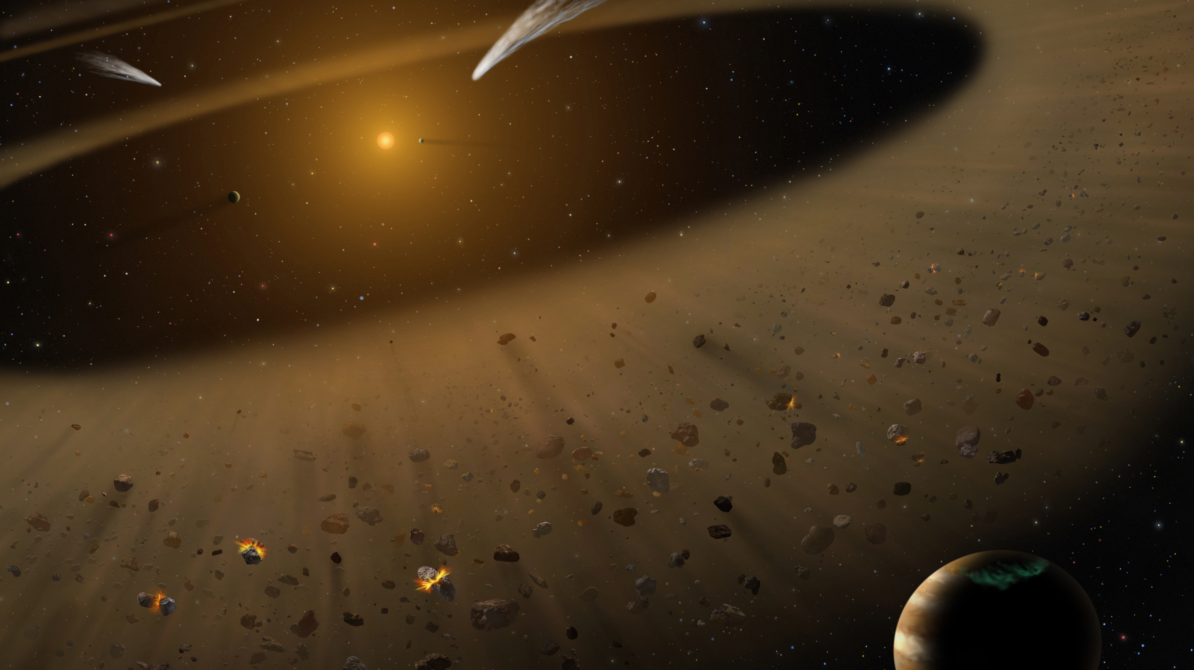



Exozodiacal Dust in the Epsilon Eridani System
Carl Ingebretsen
Mentor: Prof. Virginie Faramaz

Slide 2
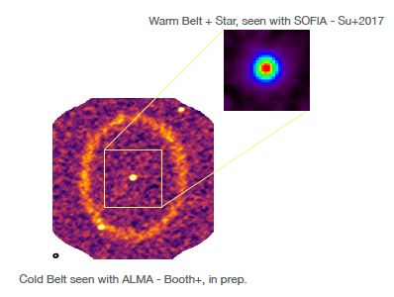
Facts About the Eps Eri System
Images of the Eps Eri Disks
A Solar Type Star 10.5 light years away from the Solar System.
It has two observed debris disks.
It has one known planet called Eps Eri b and one inferred planet, Eps Eri c, from the shape of the outer debris disk.
It is estimated to be 800 million years old.
Booth et. al. in prep
Carl Ingebretsen

Slide 3
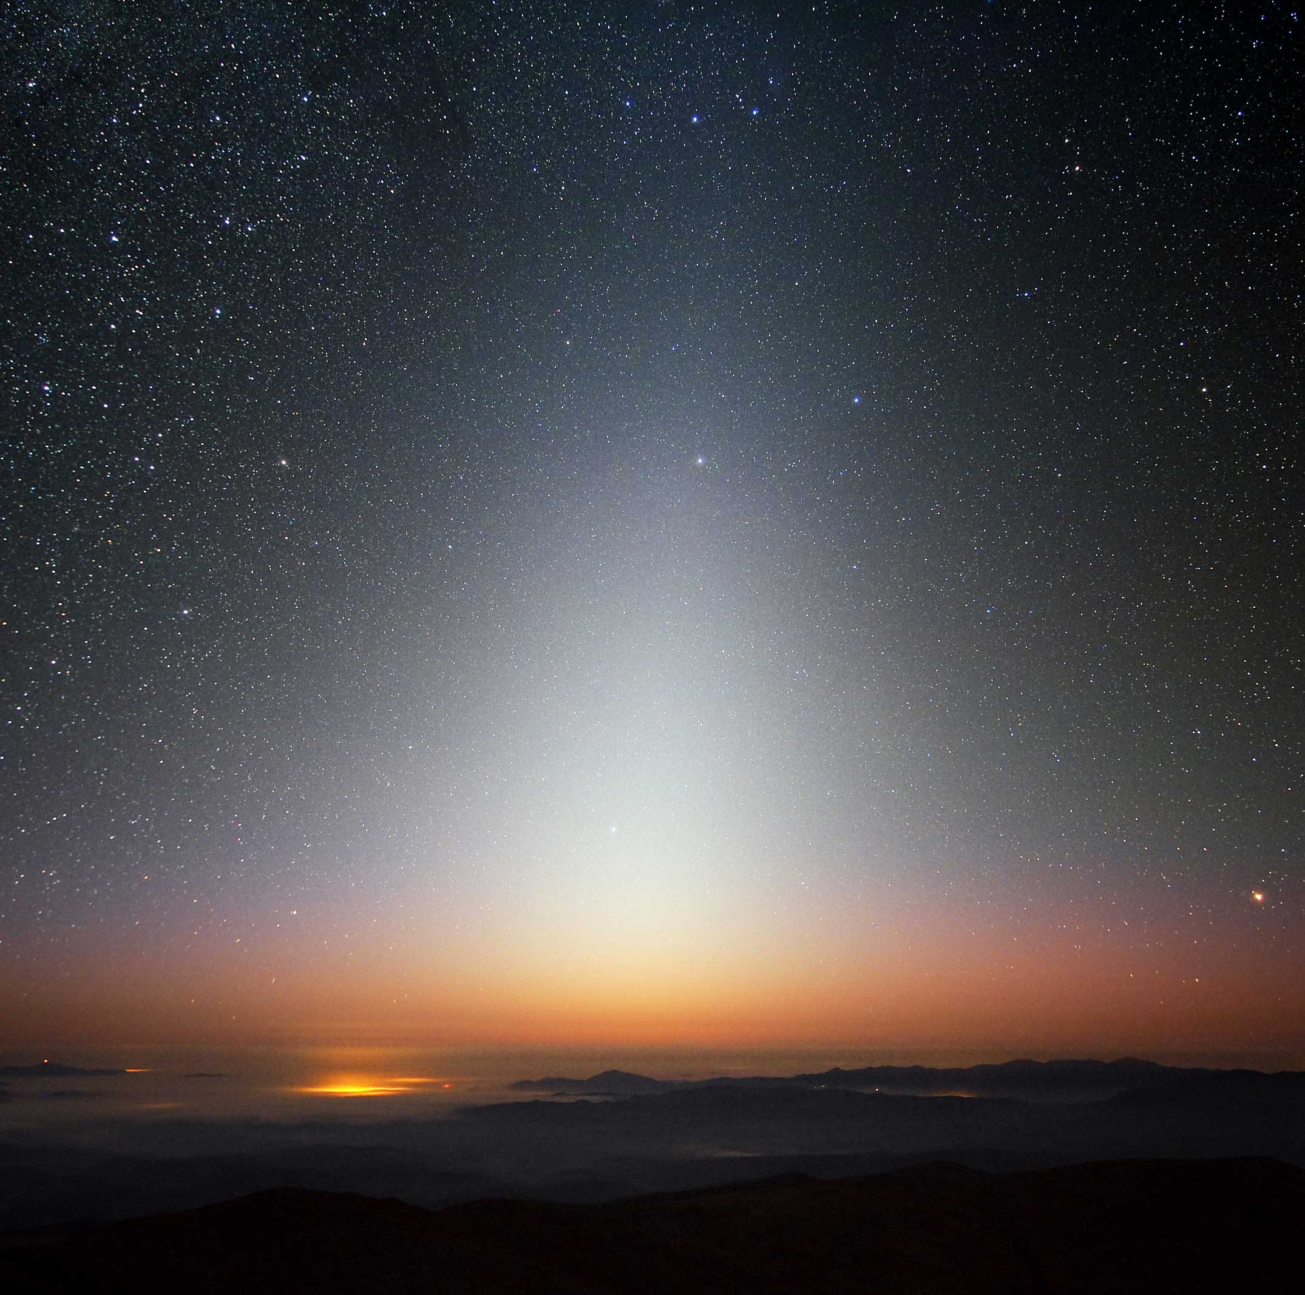
What is an ExoZodi?
The Zodiacal Light
An exozodi is ~1 micrometer sized dust found in the habitable zone of a planetary system.
It is analogous to the zodiacal light in the Solar System.
The amount of dust is unusually large in the Eps Eri system. (724+/-201 times the dust of the solar system)
The dust is short lived and thus must be continuously replenished.

Slide 4
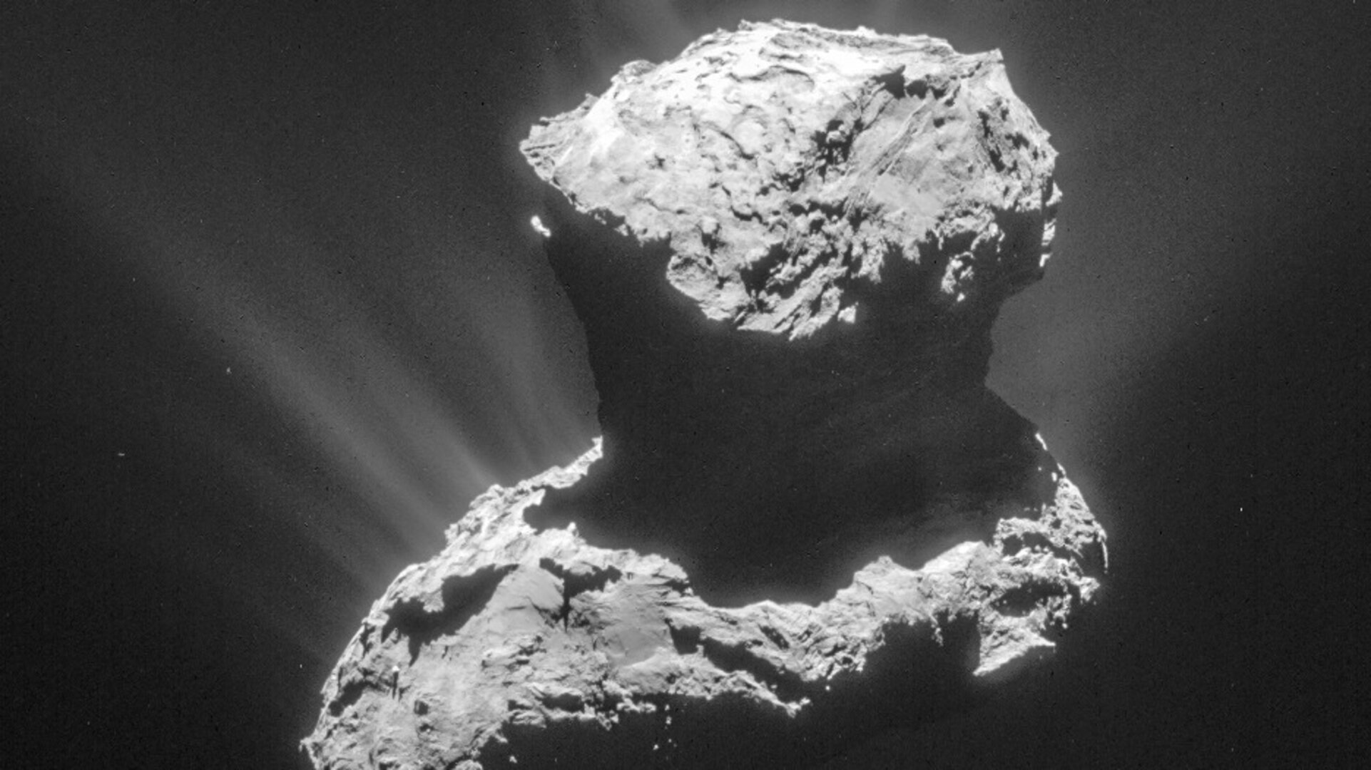
Where do Exozodi Come From?
Comet Rosetta
Comets can disintegrate and deposit dust into the inner regions of the system.
Eps Eri has a two large comet reservoirs and two planets acting on them.
The comets are sent on wild orbits due to interactions with planets to the inner regions of the system
NASA
Hypothesis: One or both planets act on the comet belts to create the observed exozodi.

Slide 5
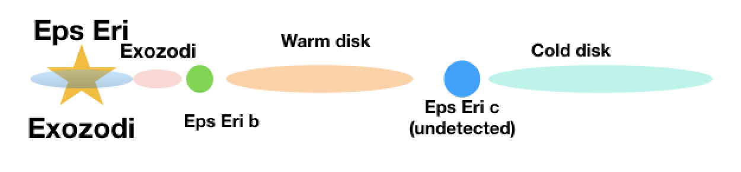
Approach
Selected Mean Motion Resonances (MMR) from analytical predictions were investigated using N-body simulations.
Each simulation was run with 5000 comets in a 1AU wide ring centered on a mean motion resonance.
These simulations are run on the supercomputers on the University of Arizona campus
The data extracted from the simulation is a record of how many comets pass interior to a particular radius.
We chose 3AU since this is the radius of the exozodi.
Carl Ingebretsen

Slide 6
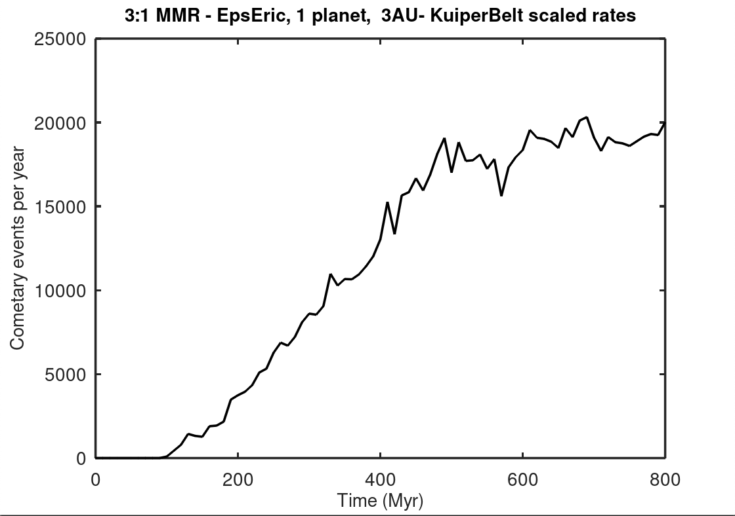
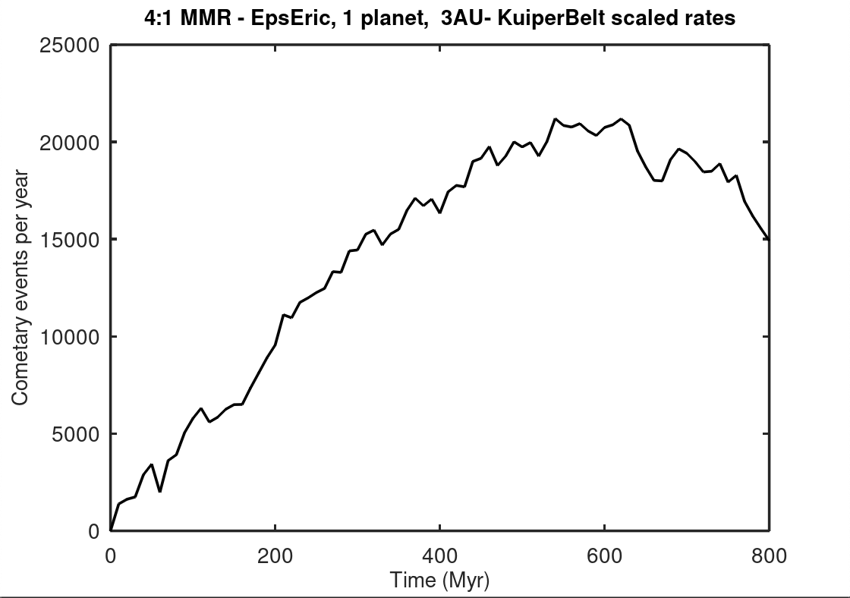
Were Comets Disturbed?
Negligible cometary activity for the following mean motion resonances: 1:3 with Eps Eri b, 1:4 with Eps Eri b, 1:2 with Eps Eri c , 3:5 with Eps Eri c and 4:7 with Eps Eri c.
Significant cometary activity for 3:1 and 4:1 mean motion resonances with the proposed outer planet Eps Eri c.

Slide 7
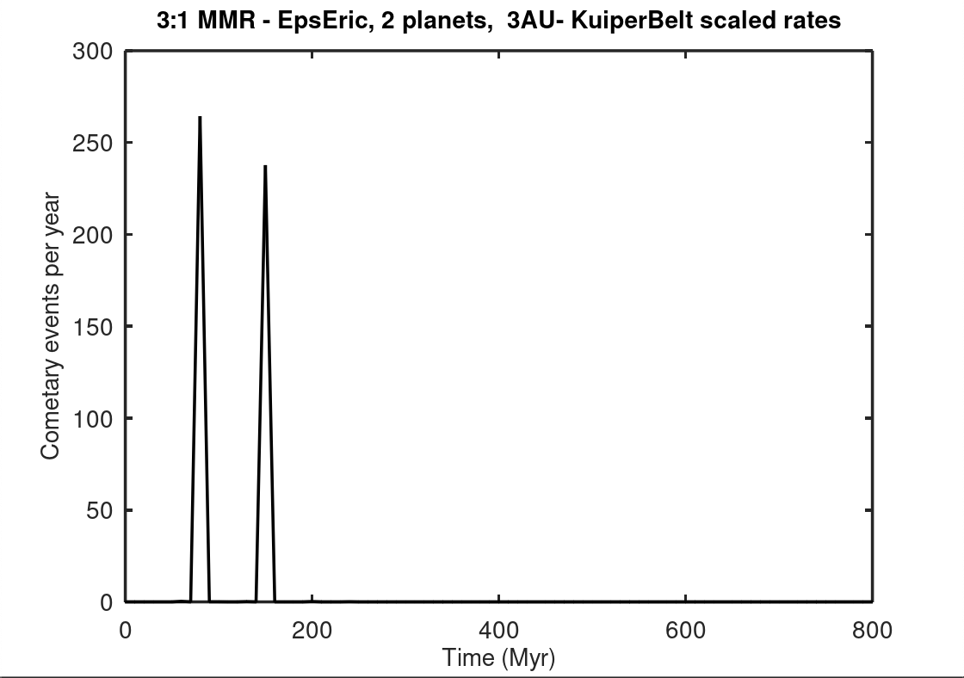
One Planet vs. Two Planets - 3:1 MMR

Slide 8
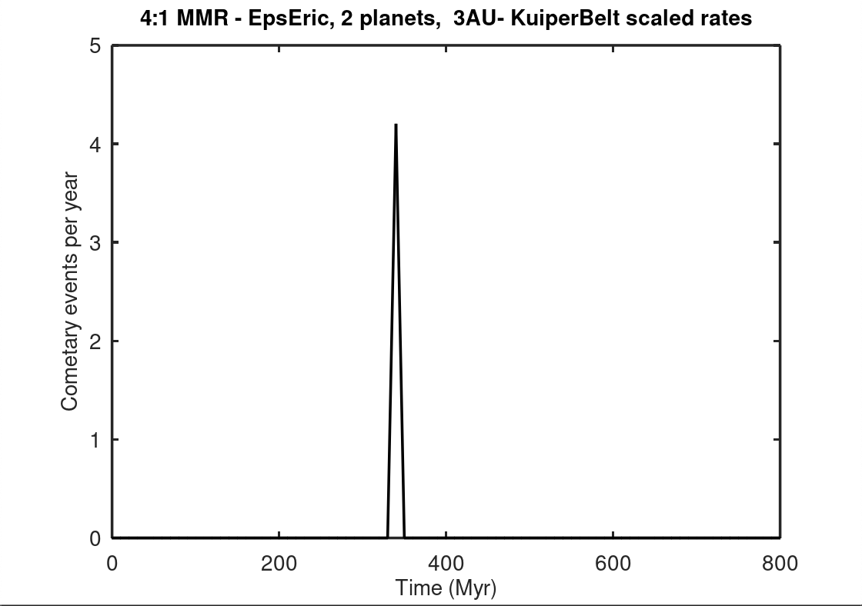
One Planet vs. Two Planets - 4:1 MMR

Slide 9
What Does This Mean for the Future?
The 4:1 and 3:1 inner resonances with Eps Eri c alone produce a large number of cometary events.
However, with two planets, the shielding was almost complete.
In the future, simulations with more test particles could lead to better analysis.
More work is needed to truly determine the origin of Eps Eri’s exozodi.
This needs to be analyzed to support detecting earth like planets around nearby stars.
Exozodis are an indication of material reaching the Habitable Zone.
Exozodis can make it difficult to characterize planets in the Habitable Zone.
Carl Ingebretsen

Slide 10
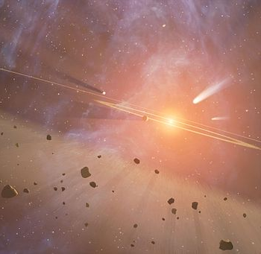

Thank You
Special thanks to Prof. Faramaz for her great mentorship, the Arizona Space Grant Consortium, and Steward Observatory for all their support.
Carl Ingebretsen

